Slide 1
Tracked
Out
Chan Lee
Jacob Malcy
Eric Grover
Devin Burke
James Douthit
Spencer Holm

Slide 2

Tracked
Out
Chan Lee
Jacob Malcy
Eric Grover
Devin Burke
James Douthit
Spencer Holm

Slide 3
Tracked
Out
Chan Lee
Jacob Malcy
Eric Grover
Devin Burke
James Douthit
Spencer Holm

Slide 4

Tracked
Out
Chan Lee
Jacob Malcy
Eric Grover
Devin Burke
James Douthit
Spencer Holm

Slide 5
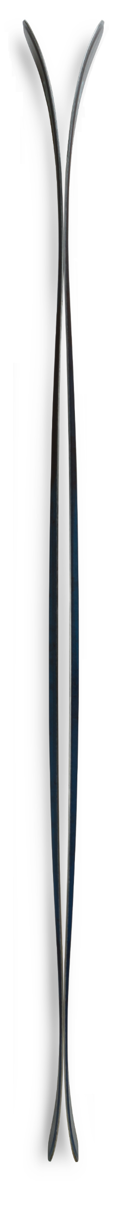
Tracked
Out
Chan Lee
Jacob Malcy
Eric Grover
Devin Burke
James Douthit
Spencer Holm

Slide 6
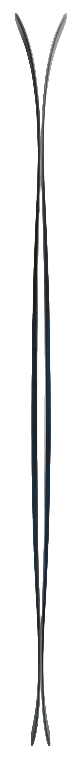
Tracked
Out
Chan Lee
Jacob Malcy
Eric Grover
Devin Burke
James Douthit
Spencer Holm

Slide 7
Tracked
Out
Chan Lee
Jacob Malcy
Eric Grover
Devin Burke
James Douthit
Spencer Holm

Slide 8

Tracked
Spencer Holm
Jacob Malcy
Out
Chan Lee
Eric Grover
James Douthit
Devin Burke

Slide 9

Tracked
Out
Chan Lee
Jacob Malcy
Eric Grover
Devin Burke
James Douthit
Spencer Holm

Slide 10

Tracked
Out
Spencer Holm
Chan Lee
Devin Burke
Eric Grover
Jacob Malcy
James Douthit

Slide 11

Tracked
Out
Chan Lee
Spencer Holm
Eric Grover
Devin Burke
James Douthit
Jacob Malcy

Slide 12

Tracked
Out
Chan Lee
Jacob Malcy
Eric Grover
Devin Burke
James Douthit
Spencer Holm

Slide 13
App
Picture of something maybe our idea or listening to music together
Purpose:
Allow users to listen to experience music together
Userbase:
People at a ski resort

Slide 14





Project Tools
Slack
Group Communication, Project Planning
5/5
GitHub
Version Control
5/5
Heroku
Cloud Server Hosting
5/5
GroupMe
Group Communication
3/5

Slide 15
Project Management
Agile – two hour Scrums Monday 6pm CSEL
Pair Programming
Task Management Software: Slack Teamline
Picture of our schedule here

Slide 16
Challenges
Picture of some of our finished code here
And how they were overcome:
Live chat connectivity
Jacob solved this
Transferring content from Bootstrap 3 to Bootstrap 4
Someone else say how we solved this
Integration with Spotify search functionality
Spencer has solution to this

Slide 17
Stack
Picture of a stack here
Software Stack / Development Tools named and rated (Programming languages, tools)
HTML, Bootstrap CSS, jQuery, Socket.IO
Node.js with Express and Socket.IO, Spotify Web API, Spotify Web Playback SDK
PostgreSQL
Front-End
Integration Layer
Database

Slide 18
Stack Ratings
Picture of stack
HTML------------
Bootstrap CSS------------
jQuery------------
Socket.IO------------
Node.js------------
Node.js Express------------
Node.js Socket.IO------------
Spotify Web API------------
Spotify Web Playback SDK------------
PostgreSQL------------
5/5
5/5
5/5
5/5
1/5
5/5
5/5
5/5
5/5
5/5

Slide 19
Live Demo
Picture screenshot ofworking website here
https://mountain-music.herokuapp.com/
Demonstration of use flow and 3 features:
Live Chat
Playback
Queue System

